Slide 1
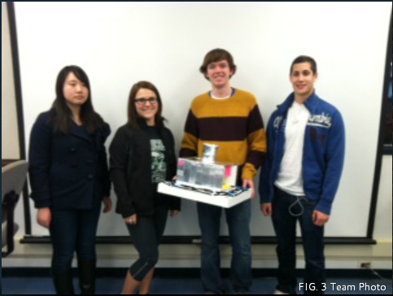
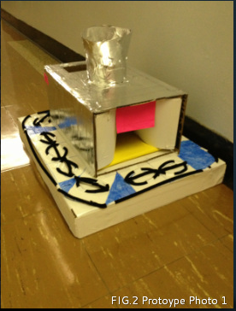
Dumplings Done Right
Anneliese Freitag, Ryan Boyle, Josh Gregov, Wenhan
Introduction to Engineering Design 100
Section: 16 Team: #3

Slide 2
Introduction
Our dumpling maker will decrease labor and increase production at a reasonable price.

Slide 3
Abstract
Before we were able to design this prototype, there was nothing else on the market to make Chinese Dumplings in one's home that was portable, easy to use, and easy to clean. This product will make it easier and more convenient for someone to make dumplings in their home.

Slide 4
Problem Statement
The process of making a good looking and tasting Chinese Dumpling is very time consuming.

Slide 5
Mission Statement
Our mission in creating this machine is to cut labor costs, time costs, and create a proportional product during each use of our Chinese Dumpling Maker.

Slide 6
Design Specifications
In order to decide what types of materials we were going to use we had to think of durability of the product and materials that were low in cost that wouldn't make the product cost over $200.

Slide 7
Structure
~Able to take off the top ~everything is detachable ~Dishwasher safe ~Structure at the top feeding stuffing into the shell ~feed the dough into the rolling pin Materials List
~Aluminum (main body) ~Plastic (attachments: i.e. shaper, cutting) PS (6) ~Wood (handles, roller) ~PVC/ Polyurethane (food belt)

Slide 8
Cost Analysis
Aluminum: $0.86 per pound PVC Pipe: $0.50 per foot Plastic: $0.40 per pound Plastic Motor Gear: $2.00 (2) Approximate price to make: $30.00 Selling Price: $60.00

Slide 9
Working Mechanism
The dough is first placed through the top of the device where the rollers flatten it. The fillings are placed into the funnel and dropped onto the dough which is transported by a conveyor belt operated by a gear system. Once the dough reaches the bottom of the conveyor belt, two cutters shape the dumpling into a circle for folding. The dumplings then roll out onto the the revolving platform. Once each folder is filled with the dough and filling within, a switch will clamp each dumpling into the proper shape. The dumplings are then manually removed from each tray and the process is repeated.

Slide 10
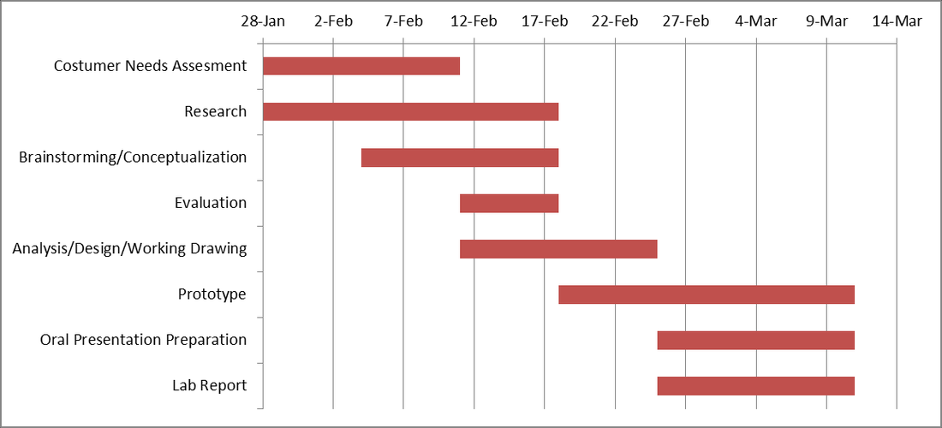
Gant Chart

Slide 11
Customer’s Needs
During the design process of our machine, we based the design off of what the customer needed from the product. We mainly found that the customer needed:
(1): an easy to use machine (2): a machine that took little time out of the customers day (3): a machine that was easy to clean and dishwasher safe (4): a machine that was durable and would last for at least 5 years (5): a machine that would consistently create an accurate product (6): a machine that took up little storage space (7): a machine that was less than $100 for the customer (8): a machine that created enough dumplings for a family/ small restaurant

Slide 12
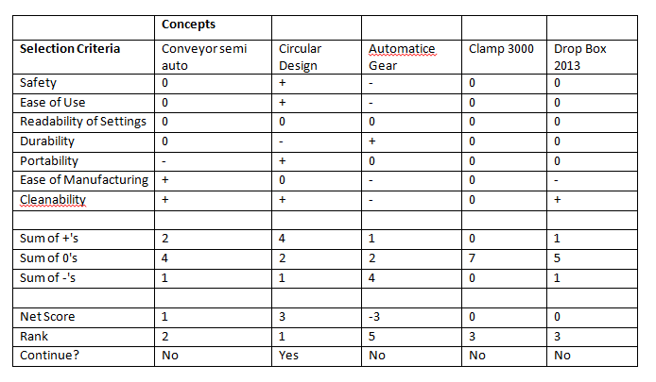
Design Selection Matrice

Slide 13
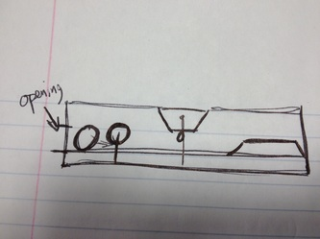
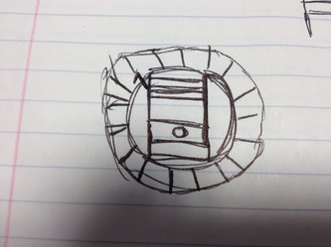
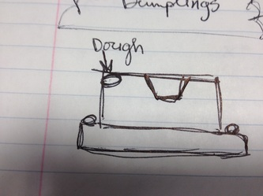
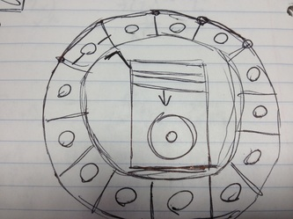
Ryan’s Original Design

Slide 14
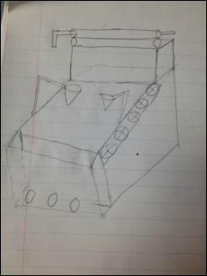
Wenhan’s Original Design

Slide 15
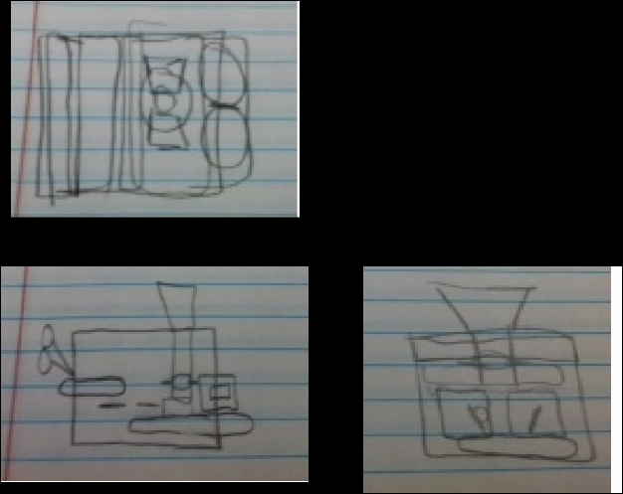
Anneliese’s Original Design

Slide 16
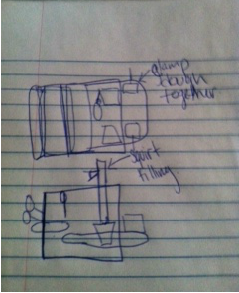
Josh’s Original Design

Slide 17
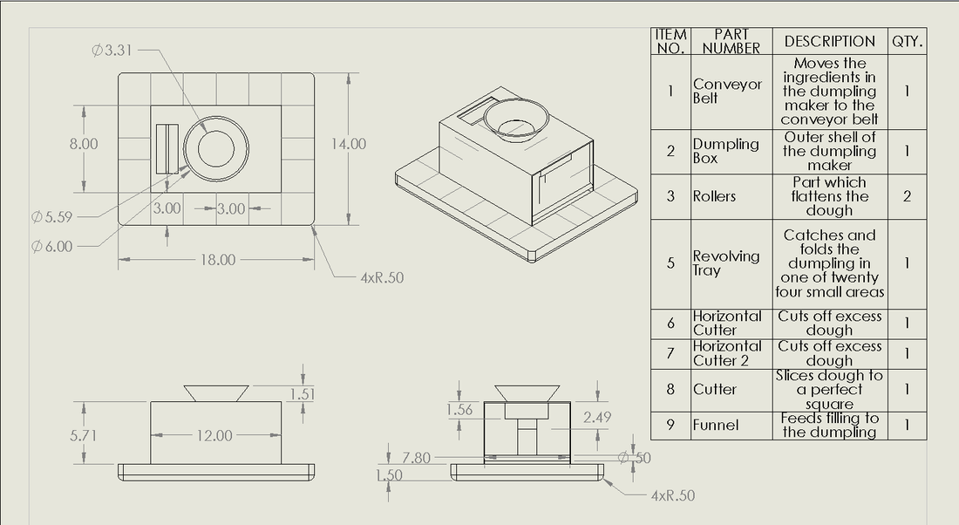
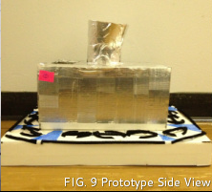
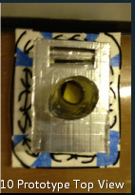
Final Product

Slide 18
Design Features
-Dishwasher Safe -Easy to Operate -Durable -Safe -Portable -Affordable

Slide 19
Operation Instructions
1. Place dough in rectangular area near rollers 2. Place fillings in the circular funnel 3. Press the on button on the side 4. When all slots are filled, flip one horizontally to fold the dumplings 5. Press on the sides to shape the dumpling 6. Open the trays and remove the dumplings 7. Remove excess dough from the trays and horizontal cutters and repeat the process until the desired amount of dumplings is made

Slide 20
Acknowledgements
Dragon of Newton
2841 S Eagle Rd Newtown, PA 18940 (215) 579-0155 Wanted a dumpling maker that could easily fit in their small kitchen with relatively fast production compared to hand made dumplings.
China Dragon
147 S Allen St.
State College, PA 16801
(814)231-8801 If someone can produce a dumpling maker which make dumpling in high speed with good quality, they would like to buy it since it can save them labor. Otherwise, they prefer to make dumplings manually.
China House
5513 William Flynn Hwy Suite 600 Gibsonia, PA 15044 (724) 443-1980 Able to attain information about making dumplings in the work place, that would make our product as accurate as possible to Chinese Dumplings.

Slide 21
The End!

